Slide 1


2026 Summit of the Americas Webinar #3 – Pre-Show Details
March 19, 2026
Presented by Kelsey Kwasniak and Jessie Nork
Notes:
[Kelsey to start webinar, wait 2 minutes, hit record and then start introduction]
[Kelsey] Welcome everyone to today’s webinar covering key event details as you prepare to submit your contract for the 2026 Summit of the Americas and select your space. My name is Kelsey Kwasniak, your Exhibits & Sponsorship Manager.
[Jessie] Hello Everyone! My name is Jessie Nork and I’m the Exhibits & Sponsorship Coordinator.
[Team goes off camera until Kelsey re-invites to join during Q&A. Kelsey continues to speak]

Slide 2

Webinar Housekeeping Notes
Reminder: All attendees can see our team as hosts but we cannot see you.
To ask a question, please type these in the Q&A feature located in your Zoom toolbar.
This webinar is being recorded and will be posted on our 2026 Summit of the Americas website under our Exhibit/Sponsor page.

Slide 3
Agenda
Dates & Location / Review of Event Space
Registration & Housing Details
Wi-Fi & Mobile App Information
Schedule Review
Networking Opportunities
Booth Package Inclusions/Exclusions
Placing Last Minute Orders with Fern
Shipping – Remember to ship to Advanced Warehouse
EAC Notice
Alcohol Sampling Reminder
Attendee List
Marketing Kit
LIVE Q&A with our team

Slide 4
Dates & Location
Show Dates – March 28 – 31, 2026
Location – Rosen Shingle Creek Resort, Orlando, FL
Primary Event Space
Panzacola F – General Session & Networking Lounge
Panzacola G/H – Exhibit Hall
Suwannee Rooms – Private Meeting Rooms
Fern Service Desk – located near the registration desk outside Panzacola G/H

Slide 5
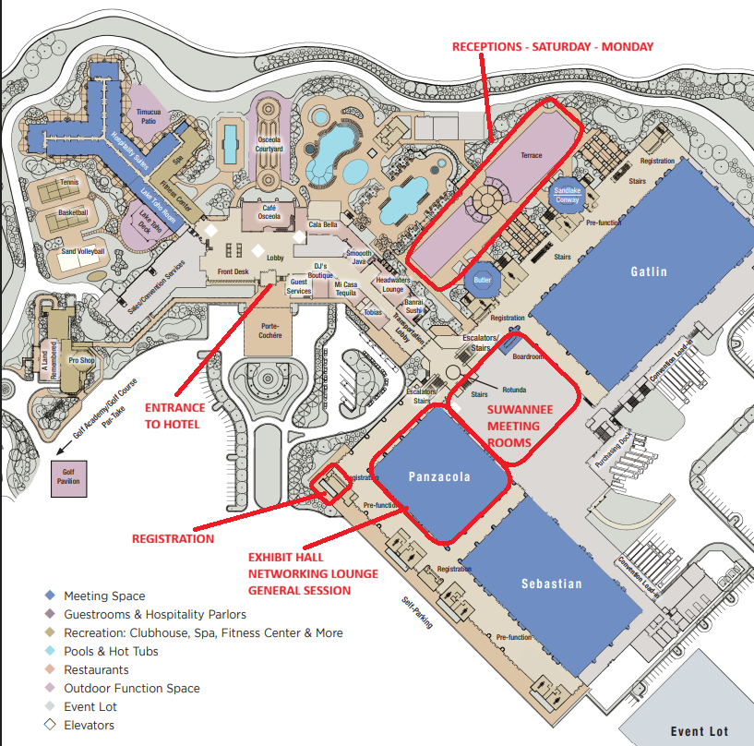
Event Map

Slide 6
Registration Details
Make sure to save time & register your booth staff in advance! Log-in credentials have been sent to the primary contact per your contract.
Exhibitors get a base allotment of (3) badges for booking space, plus (1) for every 100 square feet of space booked. For example, a 10x10 exhibitor gets (4) total badges while a 10x20 exhibitor gets (5), 10x30 exhibitor gets (6), etc.
If you are in need of assistance with the registration process, you can contact our registration team at info@summitoftheamericas.org

Slide 7
Housing Details
Summit 2026 housing is closed. To change or cancel your reservation, please contact the hotel directly.
For any alternative housing needs, we recommend contacting these nearby hotels here.

Slide 8

Wi-Fi Information
Network Name: Summit2026
Password: Avolta2026
(case sensitive)
Sponsored by

Slide 9
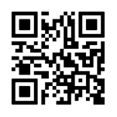

Mobile App
Download the official Summit mobile app today in the Apple App Store or Google Play Store – Sponsored by Cosper Distribution
Plan your personalized agenda, see who's attending, and network with fellow attendees all through this year’s mobile app. Get a head start and maximize every moment at this year’s Summit.
How to Download & Login
Scan the QR code
Launch the app & search “IAADFS”
Login with the email address that was used to register for the Summit.

Slide 10
Schedule Review
Review the full schedule
Exhibitor Move In
Note – if your booth is on the Panzacola F side you will be able to start move in on Saturday, March 28 at 8:00 AM.
Any exhibitor or EAC that tries to move in before Friday, March 27 cannot be guaranteed having access to their space or freight as Fern will be moving in and working to complete this before Friday, March 27 at 8:00 AM.

Slide 11

Networking Opportunities
Golf – Registration still available – DEADLINE IS TODAY!
Saturday, March 28 – 8:00 AM – 12:00 PM
Receptions
Saturday, March 28 – 6:30 PM – 8:30 PM
Sunday, March 29 – 6:30 PM – 8:00 PM
Monday, March 30 – 6:30 PM – 8:00 PM
Exhibit Hall & Private Meeting Rooms
Networking Lounge – open during exhibit hours in Panzacola F

Slide 12
Booth Package Inclusions & Exclusions
The following is included with your booth or meeting room package:
Raw Space – Hard Walls are required for booth spaces and must be ordered via the Exhibitor Services Manual
Any exhibitor with no walls onsite will be forced to purchase through Fern at their own expense.
Daily cleaning/vacuuming of the floor space
Material handling fees
Wastebasket
Trash removal
What is NOT included with your package:
Furniture
Utilities – electrical, water, etc.
Flooring – the exhibit hall and meeting rooms are all carpeted. You may still provide or order carpeting to compliment your space.

Slide 13
Last Minute Orders with Fern?
Primary contact has access to the Exhibitor Service Kit - Fern OneView
Need help accessing? Email exhibits@IAADFS.org

Slide 14
Shipping Details
REMINDER: All exhibitors should ship to the Fern Advanced Warehouse by March 25 and all freight should be labeled as follows
{Company Name - Booth #}
IAADFS 2026 Summit of the Americas
TForce c/o JM Freight
7580 Exchange Drive
Orlando, FL 32809

Slide 15
Shipping Details
If you have any temperature controlled products, this must be coordinated through Fern in advance.
If you have been approved to drive a truck to the hotel loading docks to unload freight, note Fern controls the dock spaces and will guide your driver to an available dock. Timing may vary based on dock availability.

Slide 16
Exhibitor Appointed Contractors
If you are having another company besides Fern install/dismantle your booth onsite, you must submit an EAC form and certificate of insurance to Show Management, exhibits@iaadfs.org otherwise they will not be allowed within the event space.
EACs and exhibitors cannot access the event space before Friday, March 27 at 8:00 AM. On Friday, EACs will all be given wristbands to enter the space. Exhibitors will be expected to pick-up their staff badges to access the event space for move-in.

Slide 17
Alcohol Sampling Reminder
REMINDER: if your primary product is alcohol, a bartender must be secured in advance to serve your product. No onsite bartenders can be provided last minute.
Any questions? Email exhibits@iaadfs.org

Slide 18
Attendee Lists
All primary contacts received the first Pre-Show Attendee List on Friday, January 30.
All primary contacts received the final Pre-Show Attendee List on March 13
If you did not receive, please contact exhibits@IAADFS.org.
Post-Show Attendee List – 1-2 weeks post-event
Note - all lists ONLY include attendees that opted-in to receive communications per IAADFS Privacy Policy & GDPR regulations.

Slide 19
Promote your Presence!
Don’t forget to highlight your attendance at the 2026 Summit using our Exhibitor Marketing Kit

Slide 20
LIVE Q&A With Our Team
Kelsey Kwasniak
Exhibits & Sponsorship Manager
+1-312-673-5387
kkwasniak@IAADFS.org or
exhibits@IAADFS.org
Jessie Nork
Exhibits & Sponsorship Coordinator
+1-312-673-4801
jnork@IAADFS.org or
exhibits@IAADFS.org

Slide 21
Thank you!
Kelsey Kwasniak
Exhibits & Sponsorship Manager
+1-312-673-5387
kkwasniak@IAADFS.org or
exhibits@IAADFS.org
Jessie Nork
Exhibits & Sponsorship Coordinator
+1-312-673-4801
jnork@IAADFS.org or
exhibits@IAADFS.org

